Slide 1

CYBER CRIME AND SECURITY
Presented To: Prof.Khurram Shahzad
Presented By: 22-CS-071
22-CS-015
22-CS-127
22-CS-111

Slide 2
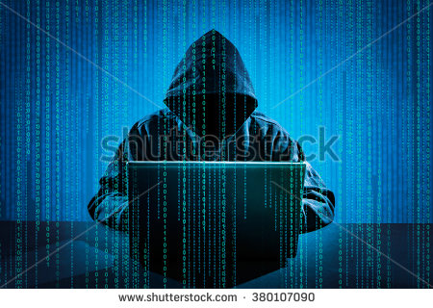
CYBER CRIMES

Slide 3
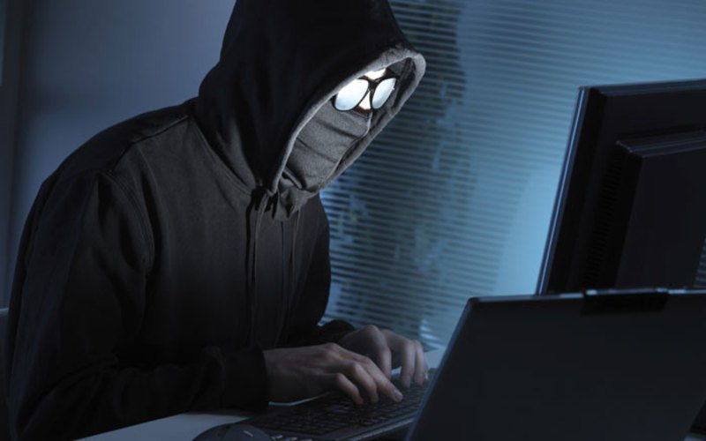
What is the Cyber Crime?
Cyber Crime is the crime
that have a computer, a
network or network
devices. These types of
crimes include viruses and
DOS (denial-of-service)
attacks.
Crimes that’s use computer
network to progression criminal activities.

Slide 4
1.Against Individual
Email spoofing: It is one in which email header is forget so that pass to originate one source but actually sent another source.
Spamming: it means send multiple copies of unsolicited mails.
Cyber Defamation: it occur when defamation take place with the help of computers or internet.
Harassment and Cyber stalking: it means following moves of an individual’s activity over the internet.

Slide 5
History
The Cybercrime Prevention Act of 2012 is one of the first laws in the Philippines which specifically criminalizes computer crime, which prior to the passage of the law had no strong legal precedent in Philippine jurisprudence. While laws such as the Electronic Commerce Act of 2000 (Republic Act No. 8792) regulated certain computer-related activities, these laws did not provide a legal basis for criminalizing crimes committed on a computer in general: for example, Onel De Guzman, the computer programmer charged with purportedly writing the ILOVEYOU computer worm, was ultimately not prosecuted by Philippine authorities due to lack of legal basis to charge him under existing Philippine laws at the time of his arrest.

Slide 6
Biggest cyber crime in 1994
1994
1:Summer: Russian crackers siphon $10 million from Citibank and transfer the money to bank accounts around the world. Vladimir Levin, the 30-year-old ringleader, used his work laptop after hours to transfer the funds to accounts in Finland and Israel. Levin stands trial in the United States and is sentenced to three years in prison. Authorities recover all but $400,000 of the stolen money.
2:Hackers adapt to emergence of the World Wide Web quickly, moving all their how-to information and hacking programs from the old BBSs to new hacker web sites.

Slide 7
Present situation
Situational crime prevention (SCP) is a relatively new concept that employs a preventive approach by focusing on methods to reduce the opportunities for crime. It was first outlined in a 1976 report released by the British Home Office.SCP focuses on the criminal setting and is different from most criminology as it begins with an examination of the circumstances that allow particular types of crime. By gaining an understanding of these circumstances, mechanisms are then introduced to change the relevant environments with the aim of reducing the opportunities for particular crimes. Thus, SCP focuses on crime prevention rather than the punishment or detection of criminals and its intention is to make criminal activities less appealing to offenders.
Notes:
Recent survey of reported crime had 96% as cyber element – either computers used to facilitate or used in commission.
Consdier the number of times, telephones/computers are used to research, facilitate crimes or used as a means of communication.

Slide 8
SCP focuses on opportunity-reducing processes that:
1:Are aimed at particular forms of crime.
2:Entail the management, creation or manipulation of the immediate environment in as organised and permanent a manner as possible; and
3:Result in crime being more difficult and risky or less rewarding and justifiable.
The theory behind SCP concentrates on the creation of safety mechanisms that assist in protecting people by making criminals feel they may be unable to commit crimes or would be in a situation where they may be caught or detected, which will result in them being unwilling to commit crimes where such mechanisms are in place. The logic behind this is based on the concept of rational choice - that every criminal will assess the situation of a potential crime, weigh up how much they may gain, balance it against how much they may lose and the probability of failing, and then act accordingly.

Slide 9
Current Scams
Invoice emails – i.e. new vendors, changes to current vendors, Apple [little mix]
Vouchers - Supermarkets, on line stores
Account updates – amazon, Sky, Virgin, Utilities
.
Microsoft/BT router/system faults – Dunstable case £4500
Mandate fraud – Bedford company lost £100K put 27 staff at risk. £1M in Luton in September. Bedford company had windows 365 compromised with poor PW. L/Buzzard company 17 fake invoices by post in Jan17.
Solicitor companies being targeted – Luton March 2017, Bedford Dec
.Ransomware – Luton Hotel attacked over New year – pay and enter suckers list

Slide 10


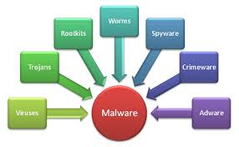
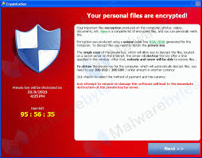
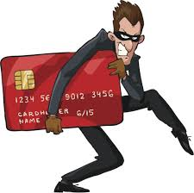

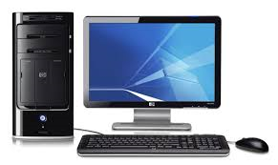
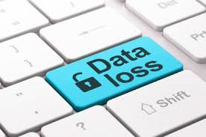
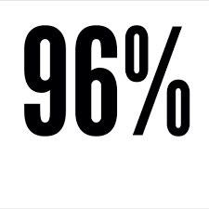




Slide 11
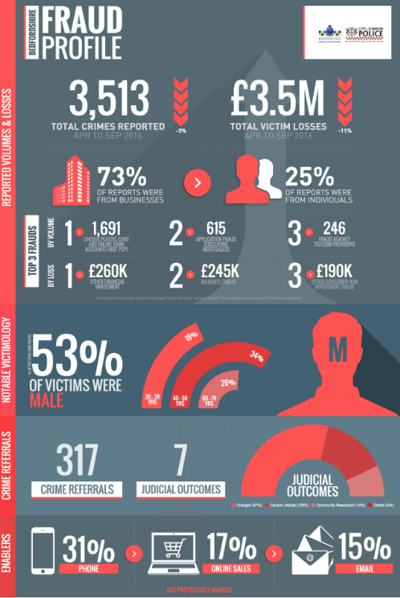
Crimes
42615 crimes recorded
2986 Burglary offences
688 Robbery offences
8900 Cyber/fraud reports (10% of reality).
Statistics therefore may suggest Cyber crime/frauds are largest number of crime in society
Highest reported incidents
Online fraud
Mandate
Ransomware
Romance frauds.
Simply not being reported:
Phishing emails / data loss/ DDOS /
internal loss by theft/fraud

Slide 12

Theft triangle

Slide 13

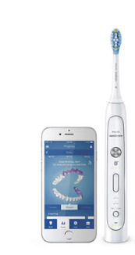
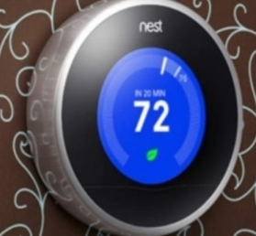
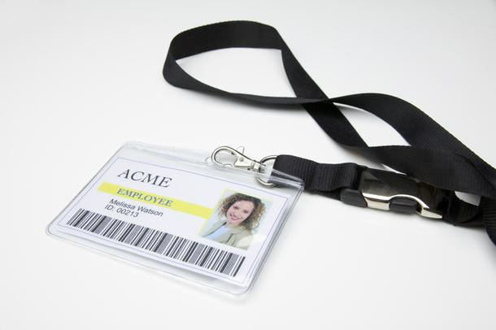

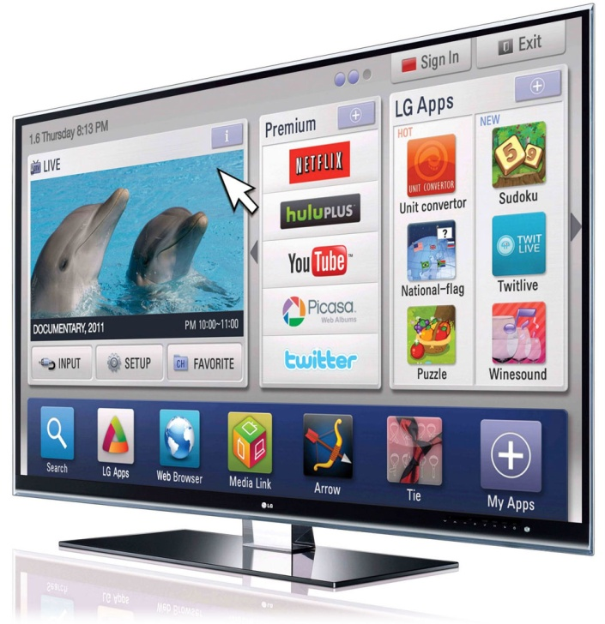
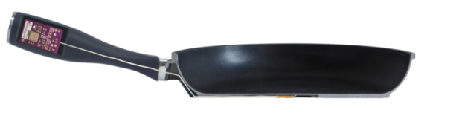
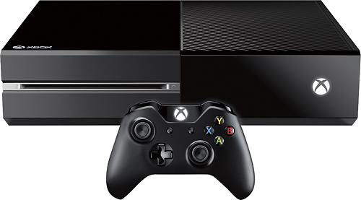
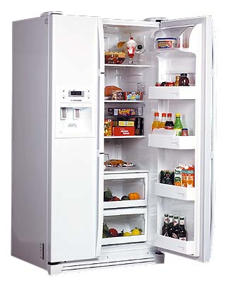
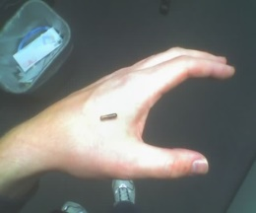
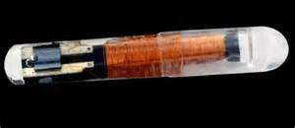
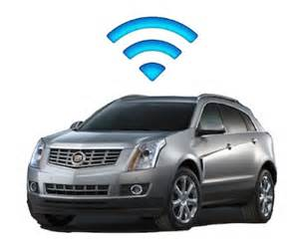
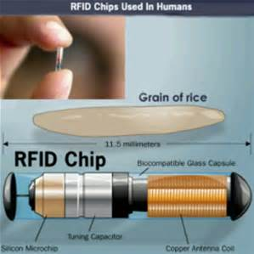
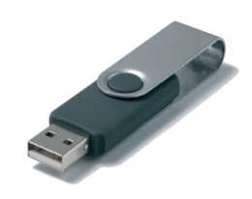

Which of these is a cyber threat?
POTENTIALLY ALL OF THEM!
Notes:
Smart fridge anecdote…
Own staff/insider
Chip in hand
Social engineering.
Frying pan
USB stick in car park

Slide 14
Law enforcement response
Obtain relevant evidence & statements from Victim (company)
Obtain server event & team viewer logs (which show who logged into server upon which data was deleted/stolen).
Obtain 3rd party data, using relevant legislation to locate IP addresses.
Execute search warrant at suspects addresses, resulting in the seizure of source devices.
Conduct examination of exhibits leading to identification of evidence which supports prosecution.
Interview suspect under caution

Slide 15
learning's
Need for Business BCP to include ICT/data loss.
Need for forensic recovery plan in disaster recovery plan.
Do not turn off devices; but remove from network (i.e. disconnect).
Do not delay response to LE, IT recovery company.
Have more than 1 ICT manager (build ICT team)
Back up key corporate and customer data.
Instigate Recovery plan & major incident processes.
Plan for such an event with Cyber essentials or
ISO 270001
Do not fail GDPR

Slide 16
But what are some of the biggest threats?
•Insider Threat (theft/fraud/data breach)
•Malware by phishing attacks
•Data Breach
DDoS
•Social Engineering leading to scams
Theft/fraud by Customers or vendors.
Ultimately it depends on the business, how it is set up, the infrastructure and the policies and procedures, and protect mechanisms in place.
Does your BCP include no use of IT or loss of data!

Slide 17

And now for some good news!!
GCHQ reported in 2014 that in terms of Cyber Crime…
80% is easily preventable
Notes:
23 in a Million phishing emails are successful
5.5 Billion in 2011 attacks world wide
42% increase in a year to £7.8 Billion in 2012
People don’t rob banks with shotguns, they now hire a hacker – lower risk and jail time if caught
Peelian Principle – First duty of any Constable is to Prevent Crime

Slide 18
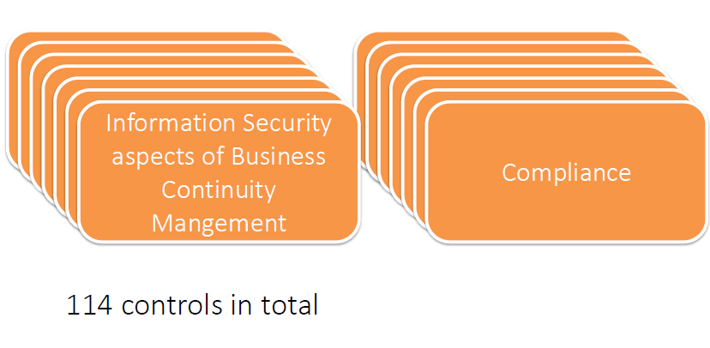
ISO27001

Slide 19
